Slide 1




Information Systems, Dashboards, & Data Analytics

Slide 2
Recap last class

Slide 3
Learning Objectives
Define the difference between secondary data and primary data,
Secondary data are statistics not gathered for the immediate study, but for other purpose.
Primary data are originated by the researchers for the purpose of the investigation at hand.
List the advantages and disadvantages of working with secondary data
Define what is meant by a marketing information system (MIS) and decision support system (DSS)
Identify the components of a decision support system
Discuss knowledge management.

Slide 4
Marketing Research Process
Once the problem has been defined, the next step is to determine if the information need ed to solve the problem already exists

Slide 5
The Marketing Research Process

Slide 6
Secondary Data
Data that have already been collected, often for some other purpose or by some other organization

Slide 7
Primary Data
Information collected specially for the investigation at hand

Slide 8
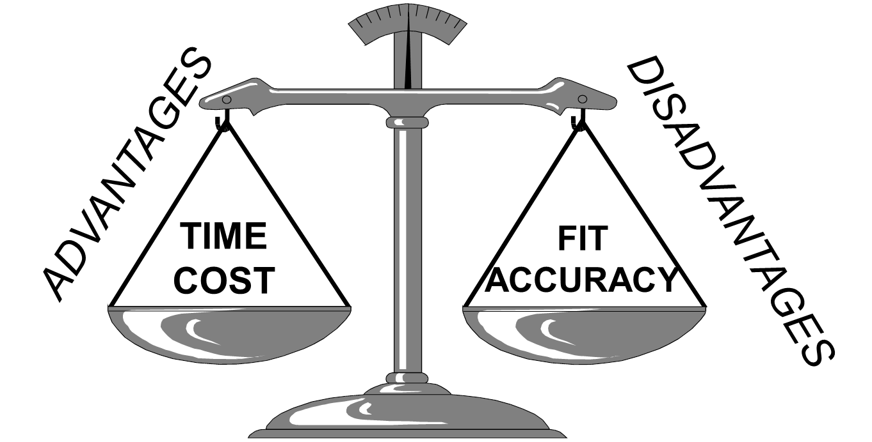
The Balancing Act with Secondary Data

Slide 9
Assessing the Accuracy of Secondary Data
Primacy of Source
Primary Source: the originating source of secondary data
Secondary Source: a source of secondary data that did not originate the data but rather secured them from another source.
Sponsor of the Research
Advocacy Research: research conducted to support a position rather than to find the truth about an issue
Evidence of Quality
Look for evidence that the researchers did a competent job. This usually means that they will have provided enough details about how the research was conducted. If they didn’t … be careful

Slide 10
Traditional Types of Internal Secondary Data
Transaction Data
For example, B2B sales invoices, retail receipts, online transactions, shopping card data
Customer Communications
For example, inquiries, complaints via telephone, online, mail, in-person.
Marketing Research Tracking Studies
For example, satisfaction, awareness, image studies
Other Sources
For example, call reports, expense receipts, customer records, financial records, credit memos, warranty cards.

Slide 11
The Evolution & Design of Information Systems
Marketing Information System (MIS)
A set of procedures and methods for the regular, planned collection, analysis, and presentation of information for use in making marketing decisions.
Decision Support System (DSS)
A system that combines data, models for guiding decision, and a user interface that allows users to interact with the system to produce customized info
Customer Relationship Management (CRM)
A system that gathers all relevant information about a company’s customers and makes it available to the employees that interact with the customers.

Slide 12
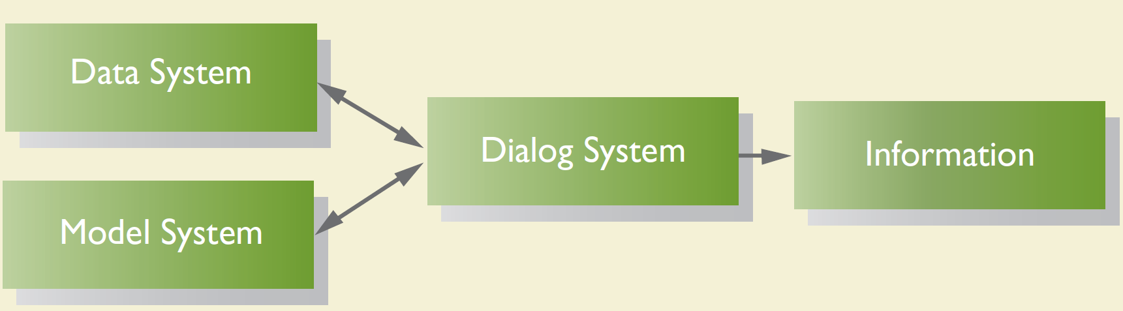
Components of a Decision Support System
Notes:
The part of a decision support system that includes the processes used to capture and the methods used to store data coming from a number of external and internal sources. It is the creation of a database.
The part of a decision support system that includes all the routines that allow the user to manipulate the data so as to conduct the kind of analysis the individual desires. It is the collection of analytical tools to interpret the database.
The part of a decision support system that includes all the routines that allow the user to manipulate the data so as to conduct the kind of analysis the individual desires. It is the collection of analytical tools to interpret the database.

Slide 13
Limitations of the Systems Approach
Managers won’t always share decision-making processes
Differing data needs across mangers
Time costs
Monetary costs
Data availability – analysis is limited to the data that are in the system.

Slide 14
Chapter 6: Decision Support Systems: Working with “Big Data”
Identify the four Versus of “big data”
Contrast structured and unstructured data
Describe the 3 sources of “big data” for marketers
Compare descriptive, predictive, and prescriptive analytical approach
List and discuss the key challenges of “big data” integration

Slide 15
“Big Data” Definition
The process of capturing, merging, and analyzing large and varied data sets for the purpose of understanding current business practices and seeking new opportunities to enhance future performance.

Slide 16
The Four V’s of Big Data
Volume: The sheer amount of data being collected in “big data” systems
Velocity: the pace of data flow both into and out of a firm
Variety: The combination of structured and unstructured data collected in “big data” systems.
Veracity: The accuracy and trustworthiness of data collected in “big data” systems.
Value:
Improving customer retention rates
Dealing with Negative WOM
Enhancing Health Care
Creating Personalized Promotions
Notes:
Research Window 6.1: Target, Big Data and You

Slide 17
Example of Big Data from structural virality paper

Slide 18
Sources of “Big Data”
Structured Data: Data that can be written into rows on a spreadsheet or database based on standard column headings
Ex: transactional data, customer profile information obtained from registration materials or other sources.
Unstructured Data: Data that take the form of social media comments, blog posts, other text-based communication, phots, video, audio, or any other form that is not easily arranged in structured format.

Slide 19
Key Types of Unstructured Data: Social Data
“Voice of the Customer” Data: unstructured posts on social media networks such as Facebook, Twitter, Google+, YouTube, Instagram, LinkedIn, Tumblr, Pinterest, etc.
Social Network Analysis: a popular tool for studying the social connections between people
Smartphone and Tablet Data: data from texting, phot sharing, in-store shopping
Location-based Services: geo-targeted text messages, mapping services, locating-sharing, location data from call records.
Notes:
Today, I will use the 5-min snippet to demonstrate SNA

Slide 20
Key Types of Unstructured Data: Omni-channel Transactional Data
Data that are connected to particular purchaser across multiple purchasing channels. Data across different platforms in potentially different formats are collected and tied together.

Slide 21
Types of “Big Data” Analyses
Descriptive Analysis: Designed to enhance understanding of available data to benefit firm performance.
Ex: data mining, data fusion, network network analysis, visualization.
Predictive Analysis: Designed to aid both explanatory and forecasting abilities for the betterment of the firm
Ex: regression analysis, time series analysis, simulation
Prescriptive Analysis: Designed to optimize the various course of action available to enhance firm performance
Ex: Optimization tools
Notes:
We have encountered simulation before, can you state some examples?

Slide 22
Key Challenges of “Big Data” Integration
Access to and retrieval of data (including data integration)
Analytic skills
Firm integration of big data

Slide 23
Recap

Slide 24
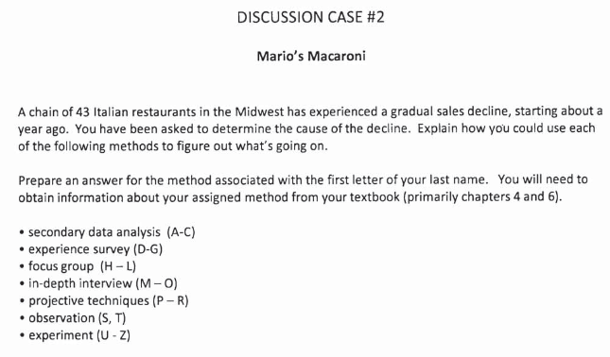
Discussion Case #2
iCliker - write your answer in 2-3 sentences on iClicker
Notes:
What could be the potential causes that a restaurant is having a gradual sales decline? Pick a specific method and consider the probable cause

Slide 25
5-min snippet: Social Network Analysis

